Slide 1
Digital Portfolio
STUDENT NAME: Ravindran
REGISTER NO AND NMID: asunm1112401111033031
DEPARTMENT: BCA
COLLEGE: Loganatha Narayana Swamy Govt College,Ponneri.
University of Madras

Slide 2
PROJECT TITLE
Personal portfolio website

Slide 3

AGENDA
Problem Statement
Project Overview
End Users
Tools and Technologies
Portfolio design and Layout
Features and Functionality
Results and Screenshots
Conclusion
Github Link

Slide 4

PROBLEM STATEMENT
Many students face difficulty in showcasing their skills, projects, and achievements in a structured and professional way. A simple yet effective digital portfolio can solve this problem by highlighting their abilities, projects, and personal details.

Slide 5

PROJECT OVERVIEW
This project is a personal Student Portfolio Website designed using HTML. CSS, and JavaScript. It presents the student's profile, skills, projects, and contact details in a visually appealing and user-friendly manner.

Slide 6
WHO ARE THE END USERS?
Students (to showcase skills and projects).
Recruiters and Companies (to evaluate student profiles).
Teachers and Mentors (for project assessment).

Slide 7

TOOLS AND TECHNIQUES
Frontend: HTML. CSS, JavaScript
Frameworks/Libraries: React (optional)
Design: Responsive Lagouts , Custom Styling
Hosting: GitHub Pages / Free Hosting Services

Slide 8
PORTFOLIO DESIGN AND LAYOUT
Clean and responsive design
Navigation menu with sections (Home. About, Skills. Projects. Contact)
Hero section with student introduction
Dedicated section for skills, projects, and contact form
8

Slide 9
FEATURES AND FUNCTIONALITY
Interactive and responsive web pages
Smooth navigation with links
Contact form for user interaction
Skills and project showcase
Mobile-friendly design

Slide 10
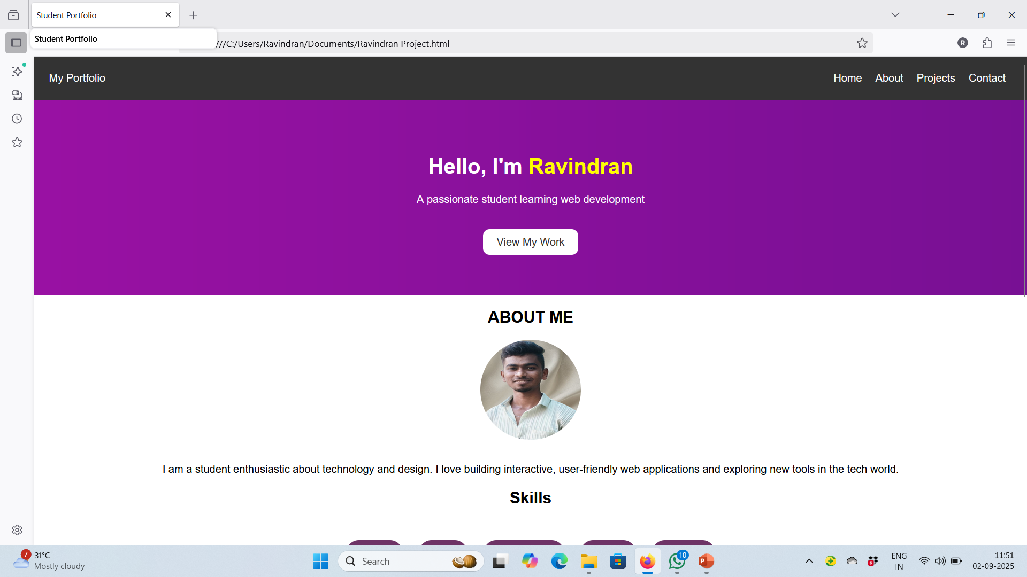

RESULTS AND SCREENSHOTS
3/21/2024 Annual Review
10

Slide 11
RESULTS AND SCREENSHOTS
Successfully created a working Portfolio Website
Includes profile, skills, projects, and contact section
Screenshots of web pages (Home. About, Projects. Contact) can be inserted

Slide 12
CONCLUSION
Successfully created a working Portfolio Website Includes profile, skills, projects, and contact section Screenshots of web pages (Home. About, Projects. Contact) can be inserted
12

Slide 13
Github Link
https://ravindran2007.github.io/Portfolio1/

